Slide 1
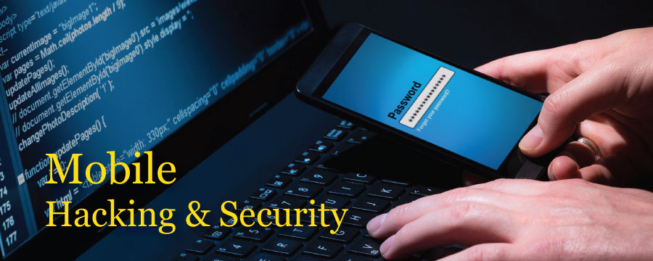
Identity security

Slide 2

PROBLEM !!:
People have so much of new ideas prompting in their mind and there are so many people who want to work securely without inviting backbitching from any friend or anyone closer who tries to be polite infront and check’s your personal information or project on which you are working so hard just in the name of friend , steal’s your idea and gets it patent on his name .
A Real Innovator can understand the pain of such ditching.
OR
Your family members wants to check your phone and you just don’t want them to do so as they may take the things in wrong way.
AND YOU CAN’T EVEN SAY
NO TO THEM!!!

Slide 3

SOLUTION:
New method of unlocking phone .
All you need to do is enter a gesture/moment which will store your values using Magnetometer Accelerometer and Gyroscope.

Slide 4
Every lock has a key......
and everyone knows that it
exits.
but what if we can hide the key
and the lock itself?????.
In everyone’s life there comes
a situation whenpeople who
are closer to us and important
to us gets to know that we are
hiding something (files/apps )from them using any
security device as app lock flashes on the screen).

Slide 5
The Interesting Part :
There will be 2 methods to unlock the phone.
1. THE TRADITIONAL METHOD:
Which include opening the phone using Sliding / Fingerprint / Pin / Pattern --- when we will unlock our phone through these locks. This will land the user into the platform that contains all those files which the user can share with the world.
2. OUR METHOD:
Which will include rotating or making a gesture through our phone -- this secret gesture will land the user into a platform which have all the apps and files that we have locked earlier using traditional methods and those applications that we want to hide and are private to us.
RESULT:
Thus our apps and files will stay protected.

Slide 6
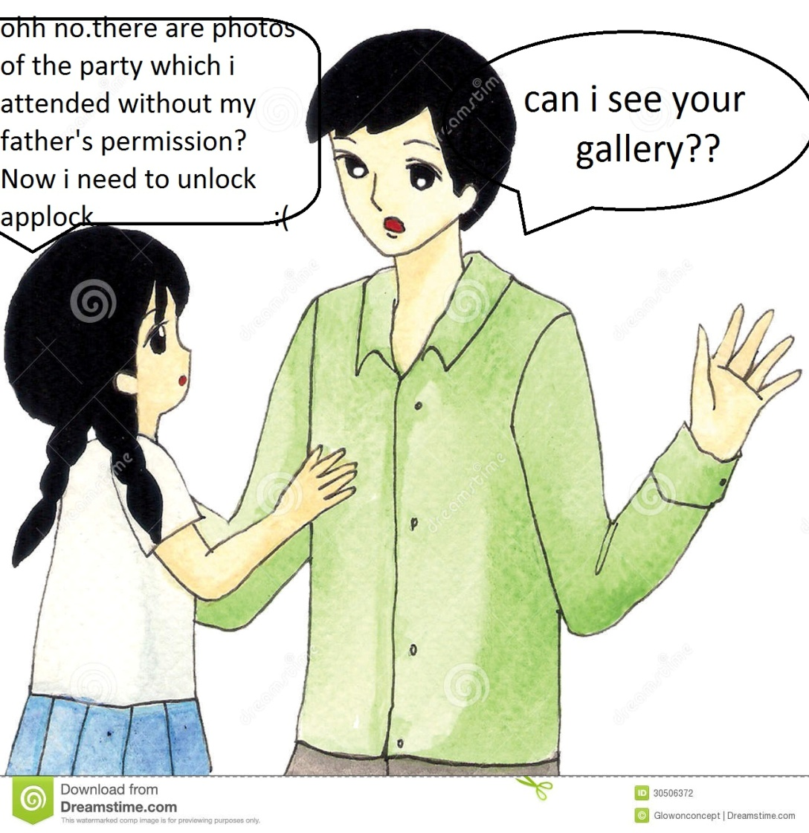
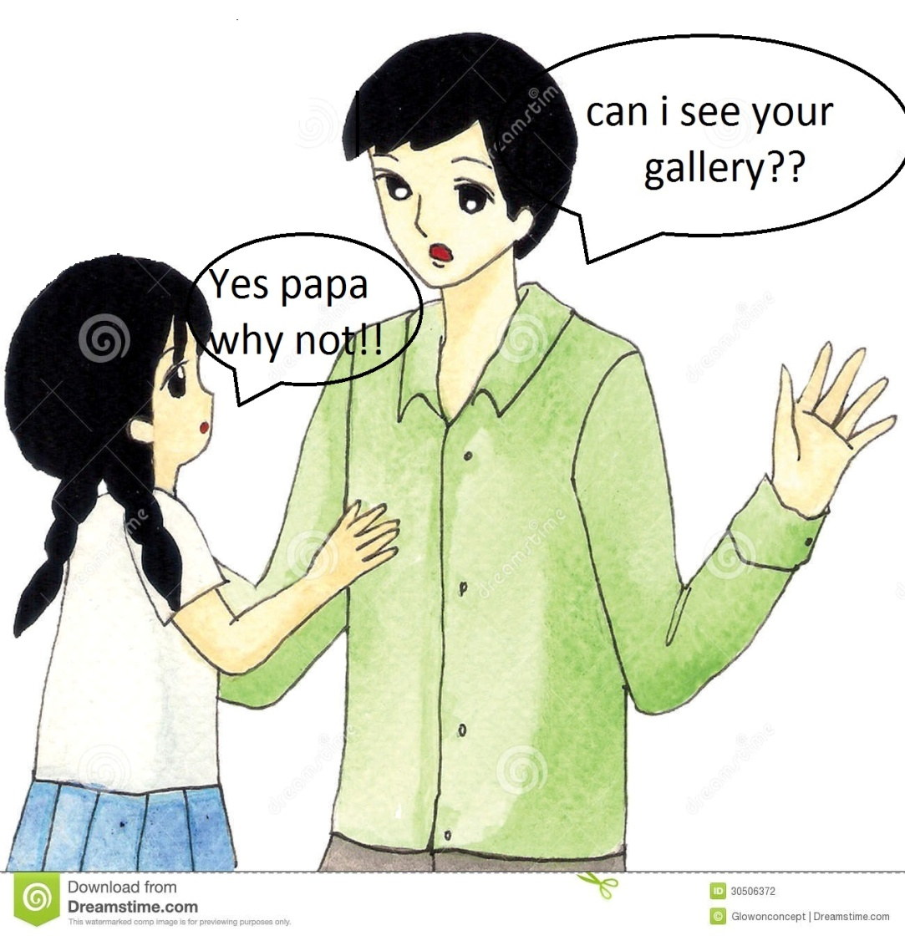
Without our app
With our app
Daughter
Father
Daughter
Father
Daughter
Father

Slide 7
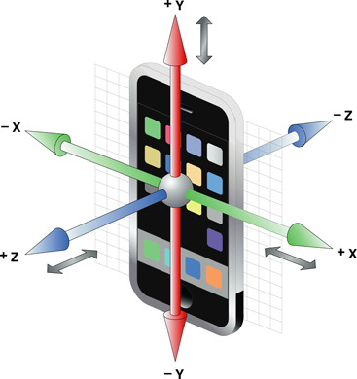
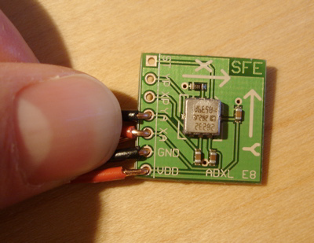
ACCELEROMETER
An accelerometer is a mechanism that lets your device, such as a smartphone, know which way up it is.
This is the sensor that tells your phone or tablet whether the screen should be in portrait or landscape mode.
One accelerometer can tell whether it is in line with the pull of gravity or not, but if you combines three of them (one for each axis) you can tell which way up something is, since each axis is fixed in relation to the device it is in.

Slide 8
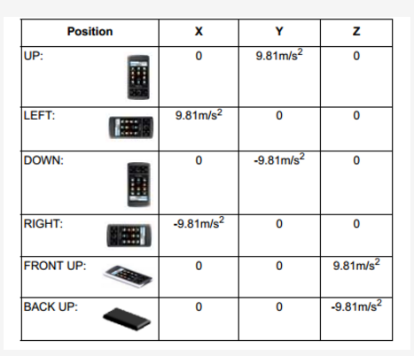
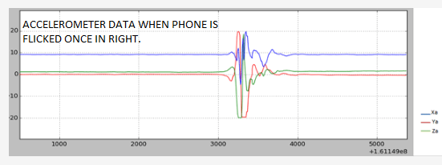
FUNCTIONING OF ACCELEROMETER
These are the values in (x,y,z )
coordinates when the positioning
of the phone is changed as
shown.
As the direction of gravitational
force
changes i.e ‘mg ‘ . The values in
x,y,z coordinate also changes.
Using these factors gestures
are alloted to a smartphone i.e
as the user wishes
to have
locking –unlocking
gestures .

Slide 9
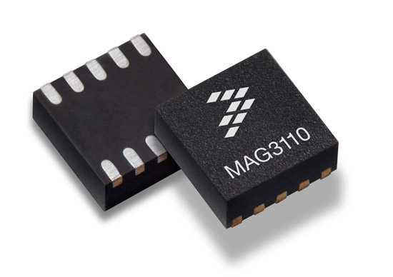
MAGNETOMETER
A magnetometer is, as you probably can tell, a device that measures magnetic fields.
Therefore it can act as a compass, by detecting magnetic North it can always tell which direction it is facing on the surface of the earth.
Can be used in conjunction with a 3-axis
accelerometer so that orientation-independent
accurate compass heading information is
achieved.

Slide 10
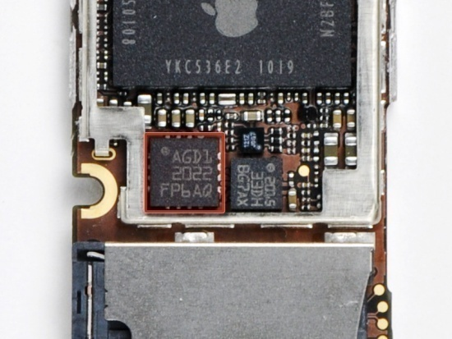
GYROSCOPE
A gyroscope is a device that can be used to calculate orientation either to help you stick to a particular orientation or to make sure you have changed to the right one.
Precisely: orientation can be computed from the
angular rate that is detected by the gyroscope,
expressed in rad/s on 3 axis.
An accelerometer measures only the linear
acceleration of the device whereas a gyroscope
measures the orientation of the device.
It can sense motion including vertical and horizontal rotation. There are a lot of practical uses of gyroscope especially in mobile games.

Slide 11
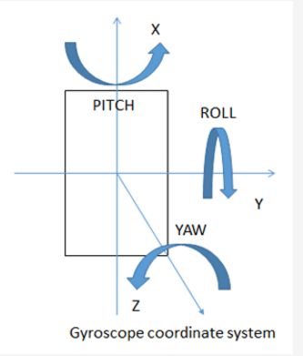
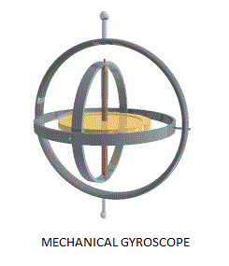
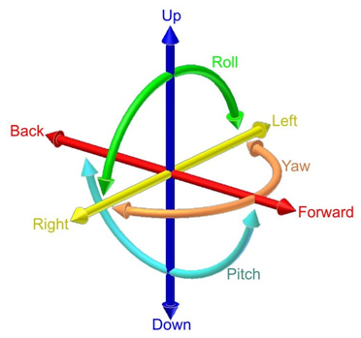
FUNCTIONING OF GYROSCOPE
It recognizes all the set of coordinates in (x,y,z) axis and stores it as a data through which when next time the user wants to open it app just compares both the readings and opens the lock.
The coordinate system of gyroscope is shown in the pictures.

Slide 12
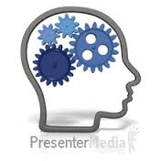
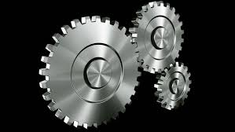
MECHANISM

Slide 13
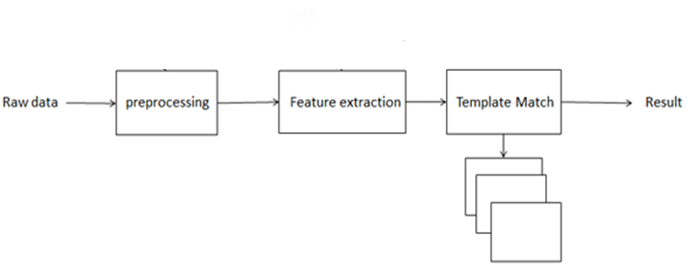
Gesture recognition process
The gesture recognition process contains preprocessing, feature extraction, and a template matching stage. Figure shows the process. In the following content, we will analyze the process.

Slide 14
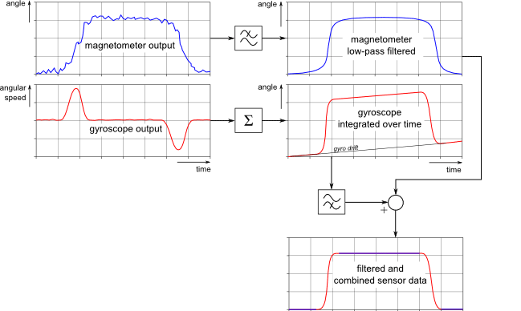
Preprocessing
After getting the raw data, data preprocessing is started. We can write a program to send sensor data by network interface using Android devices, and then write a Python* script that will be run on a PC. So we can dynamically get the sensor graphs from the devices.
In this stage we will remove singularity and as is common we use a filter to cancel noise.
The graph shows that the
device is turned 90, and then
turned back to the
initial position.

Slide 15
Feature extraction
A sensor may contain some signal noise that can affect the recognition results. For example, FAR (False Acceptance Rate) and FRR (False Rejection Rates) show rates of recognition rejection. By using different sensors data fusion we can get more accurate recognition results. Sensor fusion has been applied in many mobile devices.
The accelerometer and magnetometer are very easily interfered with by EMI. We usually need to calibrate these sensors.
Features contain max/min value, peak and valley, we can extract these data to enter the next step.

Slide 16
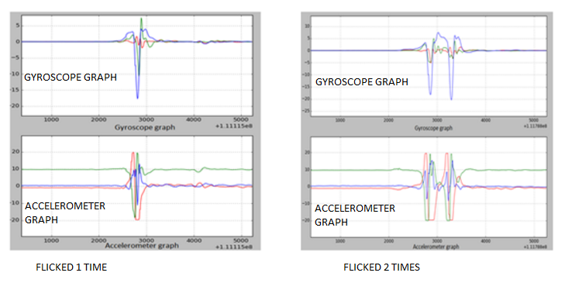
Template Matching
By simply analyzing the graph of the accelerometer sensor, we find that:
1. A typical left flick gesture contains two valleys and one peak
2. A typical left flick twice gesture contains three valleys and two peaks
This implies that we can design very simple state machine-based flick gesture recognition.

Slide 17
IMPLEMENTATION
There are two ways in which this idea can be implemented. Both the ways will use all of the readings provided by sensors. The ways are divided on the basis of availability of fingerprint scanner.
Device with fingerprint scanner- In this, one has to apply motion gesture while fingerprint scanner is scanning index finger.
Device without fingerprint scanner- In this one has to apply motion gesture while holding phone in such a way that atleast four fingers should touch screen. This method is based on the relative positions of fingers and their surface area.
Based on the values obtained by a certain motion gesture and finger print or relative positions of fingers on screen and their surface areas, the app would be able to identify a genuine user.

Slide 18
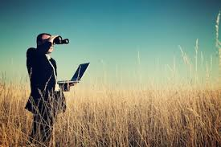
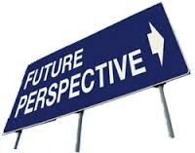
FUTURE PERSECTIVES

